Slide 1
Personas

Slide 2
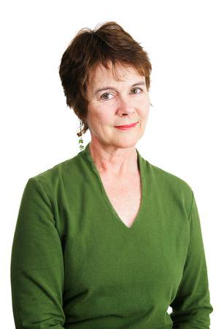
Jill – Female 56 USA
Topics of Interest
Going out in the day and then coming back to the hotel for a meal and a drink/spa session.
Things Jill likes in a website
Easy to find details about restaurant and bar. Easy to find booking button.
Jill is a 56 year old female from the USA. She is travelling to the United Kingdom with her husband and will wish to stay around Norwich for 3 nights.
Things Jill doesn’t like in a website
Complex and busy layouts. Difficult to navigate sites with lots of subsections.

Slide 3
Archie – Male 25 UK
Topics of Interest
A place to relax and drink in the evenings. A gym available in the morning/evening. Will not bother to read all of the info about the hotel, just wants to book.
Things Archie likes in a website
Convenient booking system for basic rooms. Quite a lot of nice pictures and sleek design for simple usage.
Archie is a 25 year old male from Scotland coming to Norwich on business for a couple of days at the Norwich research park.
Things Archie doesn’t like in a website
Lack of pictures and colour.

Slide 4
Samantha – Female 35 UK
Topics of Interest
A spa with treatments available and use of steam rooms etc. Cares very much about finding out details of holiday location and finding the nearest bar/club. Ideally wants to be able to order room service throughout the night.
Things Archie likes in a website
Wants it to be very fancy looking, fancy makes her want to book it. Wants to be able to change her booking to stay an extra day potentially.
Samantha is a 35 year old mum of two in Norwich for a hen do with 5 other women. The length of her trip will be 3-5 days.
Things Archie doesn’t like in a website
Bland colour schemes. Lack of social media links. Too many clickables on a page. (> 5)

Slide 5
Sebastian – Male 40 Germany
Topics of Interest
Would like to be able to call to discuss the hotel. Will read all of the information provided on the website before booking. Wants to be able to see what all parts of the hotel are like.
Things Archie likes in a website
Being able to see all booking options. A few pictures that clearly show everything about each section/room. (>5) A section for each part of the hotel (gym, restaurant etc.).
Sebastian is a 40 year old man on holiday with his family for his birthday. He intends to find somewhere to stay around Norwich for a week. He can speak English fluently.
Things Archie doesn’t like in a website
There not being a wide enough variety of pictures. Lack of number or email address.

Slide 6
Abbie – Female 18 UK
Topics of Interest
A spa facility, grounds to walk about and a restaurant all in the hotel. A pretty location and being able to see the surrounding area on the website.
Things Archie likes in a website
Pictures of everything of import in and around the hotel. Easy navigation to information about the hotel and restaurant. An address so that they can find anything exciting to do nearby.
Abbie is an 18 year old woman from Essex. She is looking to book a weekend away with her partner and would like the facilities to be present so that there is absolutely no need to leave the hotel.
Things Archie doesn’t like in a website
Dark colour schemes. Too much to read on each page. Lack of simplicity in layout.

